Slide 1

Title: IPL Strategy for RCB (Performance Analysis & Auction Optimization)
Prepared by: Anirudh Soliya
IPL DATA ANALYSIS

Slide 2

CONTENTs
Introduction
Objectives
Problem Statement
Data Overview
Database Schema
Evaluation & Insights
Advisory Recommendations
Conclusion

Slide 3

INTRODUCTION
The Royal Challengers Bangalore (RCB) has consistently showcased competitive spirit in the IPL.
Our analysis delves into the team's historical performance, highlights standout players, and evaluates strategies to improve outcomes in future seasons.
By leveraging data-driven insights, we aim to refine team dynamics, amplify strengths, and achieve greater success in upcoming campaigns.

Slide 4

Objectives
Analyze historical performance trends of RCB to uncover key success and failure patterns.
Examine the influence of home ground conditions on team outcomes and overall performance.
Identify standout players based on batting consistency, bowling impact, and all-around abilities.
Develop actionable insights and strategic recommendations to enhance RCB's future performance.

Slide 5
Problem statement
RCB aims to improve its performance in the IPL and seeks a comprehensive analysis to identify key players who can contribute effectively to the team’s success.
The team wants to focus on the players who perform well consistently, especially those excelling in both batting and bowling.
Additionally, understanding team dynamics, home-ground advantage, and factors affecting high-scoring matches are crucial for crafting a winning strategy.
Although they have not won any trophy yet, RCB is a side that can win a cup.
The primary aim of this analysis is to identify and improve their weak areas.

Slide 6

Data Overview
Data Source:
IPL dataset (various tables like matches, player, team, batsman_scored, ball_by_ball, wicket_taken, bowling_style, city, extra_runs etc).
Key Metrics Analyzed:
Batting performance: Total runs, strike rate, batting average.
Consistent players: Most Man of the Match awards
Bowling performance: Wickets taken, economy rate, bowling effectiveness.
Player versatility: Contributions in both batting and bowling.
Team performance: Match wins, home ground impact.
Tools Used:
SQL Workbench for data querying and extraction.
Excel for visualization and in-depth analysis.

Slide 7
Methodology
Step 1-
Data Extraction and preprocessing.
Using SQL queries to aggregate batting and bowling performance metrics for individual players.
Identifying player versatility by calculating metrics like strike rate, economy rate, and player impact.
Step 2-
Player Performance Analysis.
Ranking athletes based on essential metrics like total runs, wickets, strike rate, and economy rate.
Identifying players with strong batting averages, wicket-taking skills, and low economy rates.
Step 3-
Team-Level Analysis:
Evaluating home ground performance to assess the effect of the venue on match results.
Reviewing past performance of RCB across different seasons.
Step 4-
Suggestions and Strategic Choices:
Developing recommendations for RCB based on analytical insights from player performance and team dynamics.
Using data-driven analysis to suggest strategies for improving team performance and optimizing player roles.

Slide 8
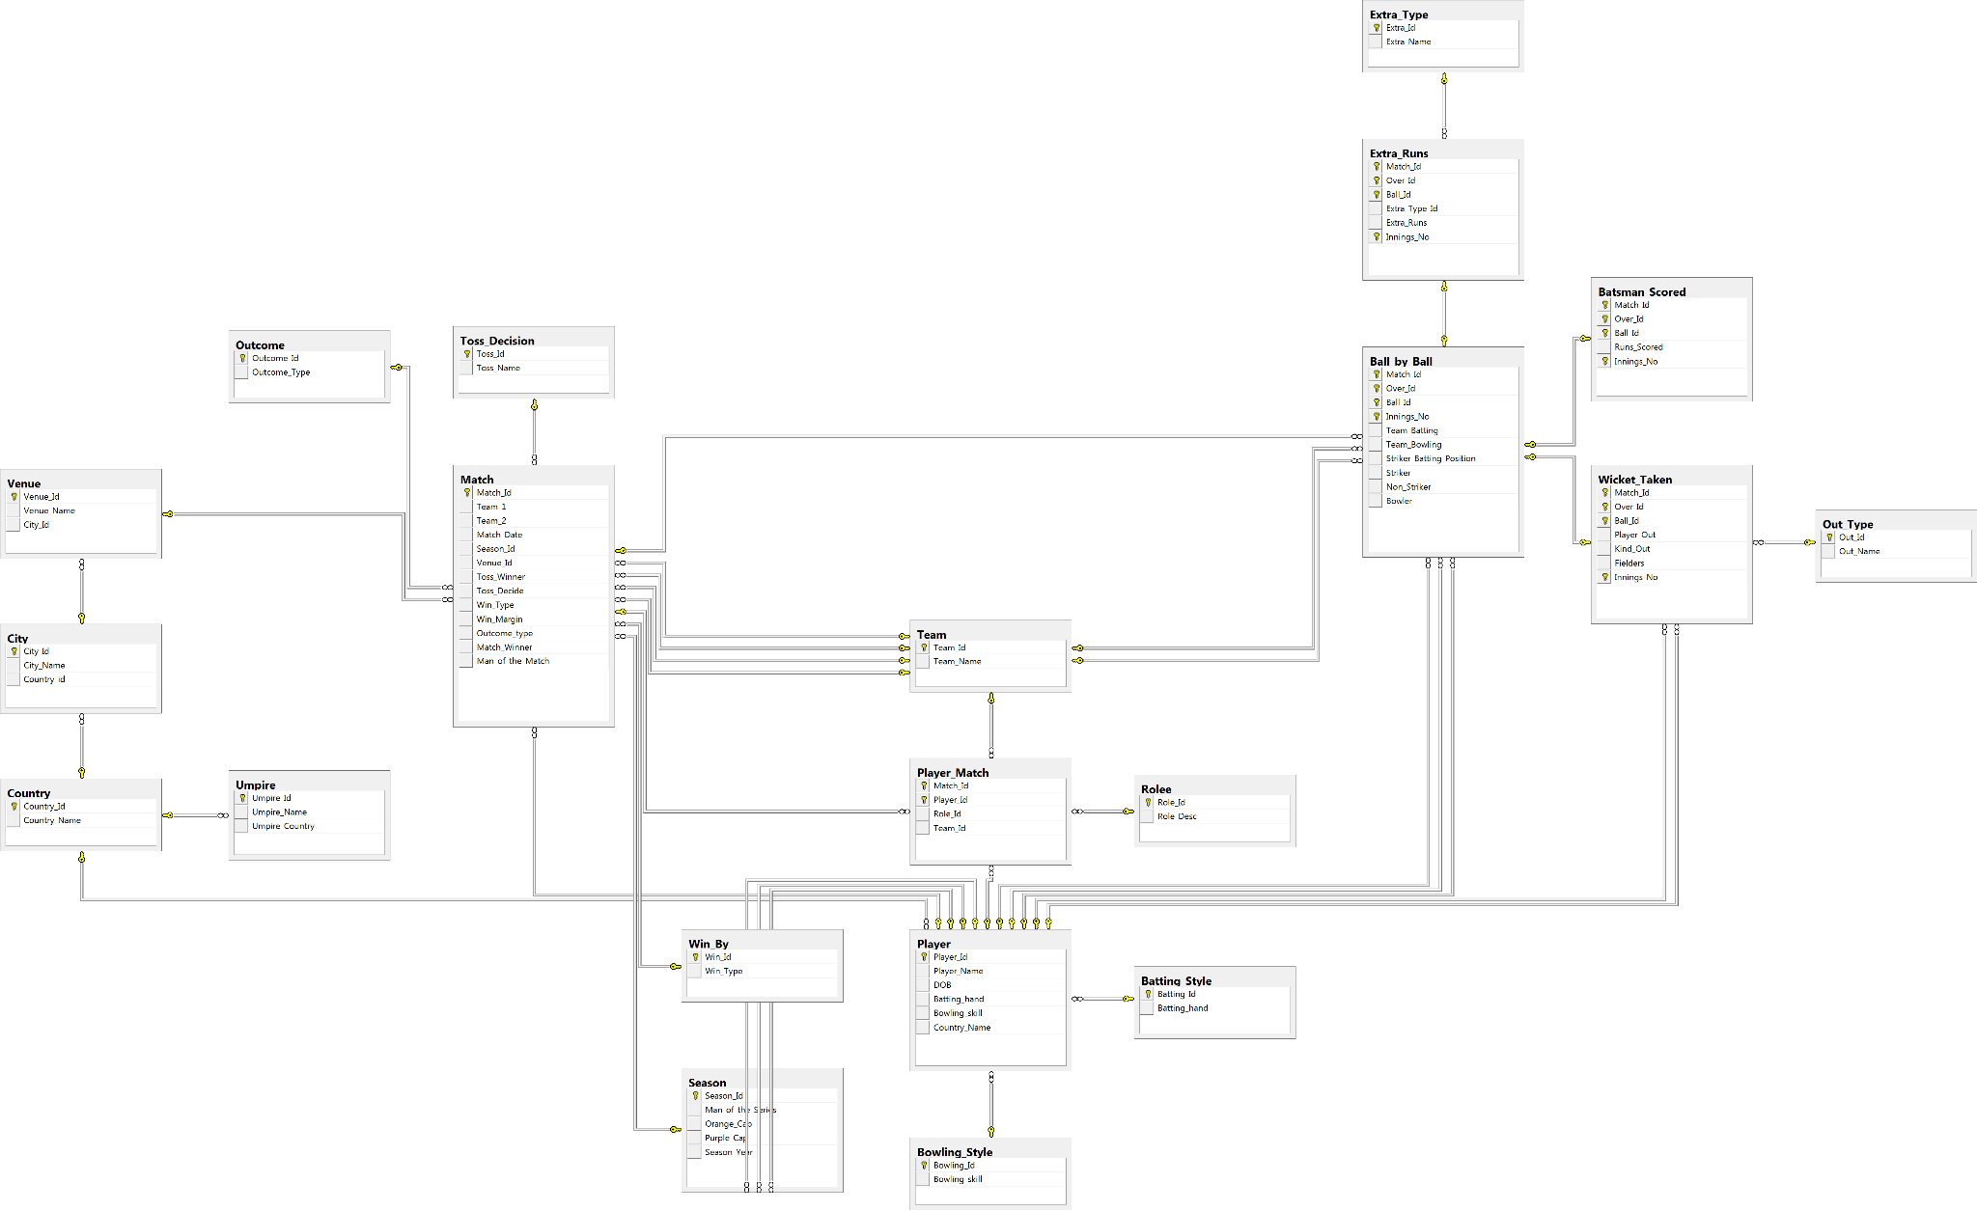
Database schema

Slide 9
Evaluation & Insights
1. Top Player In Batting Scores
Objective:
Identify standout players in batting performance, focusing on high scores, impressive averages, and exceptional strike rates.
Analysis:
Players demonstrating exceptional strike rates, consistent batting averages, and significant total runs scored across all seasons.
Insights:
Top-performing batters balance consistency and explosiveness with high runs, averages, and strike rates, excelling in stability and quick scoring.

Slide 10
Evaluation & Insights
2. Top Performers with High Batting Average
Objective:
Identify players with exceptional batting averages, highlighting those who consistently score high runs per dismissal.
Analysis:
Players with outstanding average runs per match are determined by dividing their total runs by the number of dismissals.
Insights:
Top players such as Simmons, Gayle, Marsh, Rana, Hayden, MN van Wyk and V kohli have maintained remarkable batting averages over the past five seasons.
Notably Simmons, Gayle, Marsh, N Rana and Hussey lead the pack with the highest total runs and averages.

Slide 11
Evaluation & Insights
3. Elite Contributors (with Leading Match Impact Awards)
Objective:
Identify players demonstrating exceptional consistency by analysing those with the most "Man of the Match" awards.
Analysis:
Players earning the most "Man of the Match" awards highlight their consistent high-impact performances and overall excellence on the field.
Insights:
An analysis reveals that players like CH Gayle, YK Pathan, AB de Villiers, Warner, RG Sharma and Raina stand out as consistent performers. They lead in "Man of the Match" awards, total runs scored, and batting averages, cementing their status as top-tier players.

Slide 12
Evaluation & Insights
4. Dominant Players in Death Overs
Objective:
Identify players who excel in the death overs (final four overs of an innings) based on their scoring performance, with a minimum of 20 matches played.
Analysis:
Players with exceptional batting averages in the death overs were evaluated for their impact.
Insights:
Explosive finishers like V Kohli, AB de Villiers and MS Dhoni have consistently dominated the death overs, capitalizing on scoring opportunities to secure match-winning finishes.

Slide 13
Evaluation & Insights
5. Boundary Specialists (with Most Fours and Sixes)
Objective:
Identify players known for their power-hitting abilities, based on the highest number of boundaries (fours and sixes) scored.
Analysis:
Players who consistently hit the most boundaries (fours and sixes) are considered dominant power hitters.
Insights:
Players like V Kohli, Raina, Gayle, RG Sharma, Warner and Dhawan stand out as top performers due to their high strike rates, excellent averages, and exceptional power-hitting ability. They are ideal choices for mega auctions.

Slide 14
Evaluation & Insights
6. Elite Batting and Bowling Contributors
Objective:
Identify players who excel in both batting and bowling, contributing significantly in both disciplines.
Analysis:
Players with impressive total runs and wicket tallies were evaluated for their all-round capabilities.
Insights:
Exceptional all-rounders like DJ Bravo, Pollard, Watson, and Jadeja stand out for their ability to combine explosive batting with reliable bowling.
Such players offer crucial versatility for RCB, particularly in scenarios demanding adaptability. Their dual impact consistently shifts the momentum in matches across both innings.

Slide 15
Evaluation & Insights
7. RCB's Win & loss Percentage on toss Decision
Objective:
Examine how toss decisions (batting first or chasing) affect match outcomes.
Analysis:
Compared the win/loss ratios of teams that chose to bat first versus those that opted to chase.
Insights:
Teams that choose to bat tend to have a higher win percentage.
RCB shows better performance when batting, emphasizing the importance of winning the toss and making strategic decisions.
Toss decisions play a crucial role in performance, especially at high-scoring venues.

Slide 16
Advisory Recommendations
1. Enhancing Bowling Strategy in Death Overs
Objective:
Enhance RCB's performance in the death overs (16-20) by improving bowling strategies to control the run flow and limit the opposition's scoring opportunities.
Analysis:
The final overs (16-20) often determine the outcome of a match, and RCB has struggled in this phase, particularly in bowling.
Insights:
Focus on acquiring death-over specialists like Malinga, Bravo, Mishra, Vinay Kumar, and Harbhajan Singh to effectively manage the run flow.
Utilize bowlers with a proven track record in the death overs to reduce the opponent's scoring rate, concentrating on accurate yorkers and slower balls.

Slide 17
Advisory Recommendations
2. RCB Victory Rate at Different Venues
RCB's winning percentage fluctuates across different venues.
Notably, venues like Brabourne Stadium and Maharashtra Cricket Association have seen RCB maintain a 100% winning record, but this is based on only one match played at these venues.
With a strong batting lineup, opting to bowl first during the toss can enhance the winning percentage on smaller grounds, while on larger grounds, the opposite approach may be more effective.

Slide 18
Advisory Recommendations
3. Emphasize the most efficient bowler
Insight:
The final overs (16-20) are critical phases where games can significantly turn, and RCB has struggled, especially with their bowling performance.
Recommendation:
Focus on recruiting specialists for the closing overs, such as Malinga, Bravo, Mishra, Vinay Kumar, Harbhajan Singh, etc., to restrict runs effectively.
Deploy bowlers who excel in the final overs to curb the opposition’s scoring, emphasising precise yorkers and deceptive slower deliveries.
Target bowlers with expertise in the death overs to tighten run flow, leveraging skills like accurate yorkers and well-timed slower balls.

Slide 19
Advisory Recommendations
4. Highest wicket-taking trio for each stadium.
Insight:
Venue-specific performances show SL Malinga thrives at Wankhede, R Ashwin dominates at Chepauk, and SK Trivedi excels at Sawai Mansingh.
Recommendation:
Venue-Based Strategy: Use spinners on slow pitches and death-over specialists on batting-friendly tracks.
Death-Over Execution: Recruit bowlers skilled in yorkers and slower balls.
Bowling Pairs: Combine pacers and spinners for strategic advantage.

Slide 20
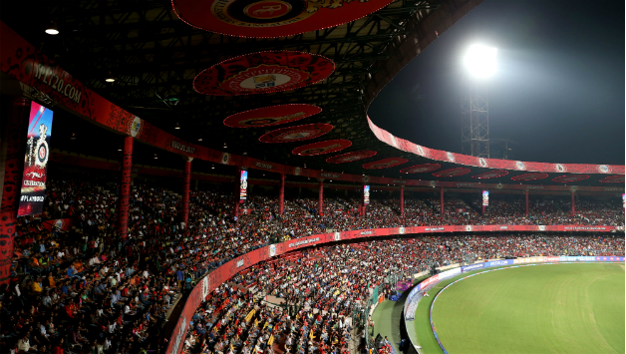
Advisory Recommendations
5. Leveraging Home Ground Benefits
Insight:
M. Chinnaswamy Stadium is known for high scores, benefiting teams with aggressive batters.
Recommendation:
Enhance batting strength with big hitters like Glenn Maxwell, Gayle, and AB de Villiers to exploit shorter boundaries.
Leverage home conditions by focusing on fast-scoring batters and bowlers skilled at containing runs in high-scoring matches.
RCB should opt to chase more often at home, where they have historically performed better when batting second.
M. CHINNASWAMY
STADIUM

Slide 21
conclusion
RCB's batting lineup, featuring Kohli, Gayle, and de Villiers, is strong.
There is excessive reliance on these key batters. The team needs backup all-rounders like Watson, Bravo, Jadeja, Pollard, Warner, and Pathan.
Focus on assembling versatile players and death-over specialists.
Strengthen the bowling unit with players like Narine, Ashwin, Kumble, Malinga, and Harbhajan Singh.
Consistent application of these strategies will enhance RCB's performance and boost their chances of winning the IPL trophy.

Slide 22
Thank you

